Slide 1



Chapter 9
The Logic of
Experimental
Design
@ 2012 Wadsworth, Cengage Learning

Slide 2
Topics
Between-Subjects Experimental Designs
Correlated-Groups Designs

Slide 3
Between-Subjects Experimental Designs

Slide 4
Between-Subjects
Experimental Designs
Between-subjects design: an experiment in which different subjects are assigned to each group
Experimentation involves control
Control who is in the study
  Random sampling
  Random assignment of subjects to the conditions

Slide 5
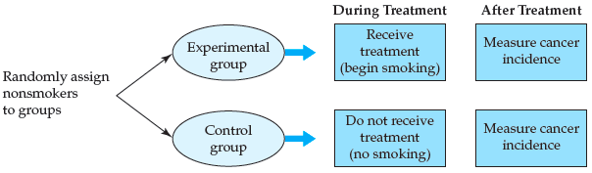
Between-Subjects
Experimental Designs (cont’d.)
Figure 9.1 Experimental study of the effects of smoking on cancer rates

Slide 6
Between-Subjects
Experimental Designs (cont’d.)
Posttest-only control group design
  An experimental design in which the dependent variable is measured after the manipulation of the independent variable
Pretest/posttest control group design
  An experimental design in which the dependent variable is measured both before and after manipulation of the independent variable

Slide 7
Between-Subjects
Experimental Designs (cont’d.)
Disadvantages of the pretest/posttest control group design:
  Possibility of increasing demand characteristics and
  Experimenter effects
  Subjects might guess before the posttest what is being measured in the study
  With multiple testings, more opportunity for an experimenter to influence the subjects

Slide 8
Control and Confounds
Confound: an uncontrolled extraneous variable or flaw in an experiment
Internal validity
  The extent to which the results of an experiment can be attributed to the manipulation of the independent variable rather than to some confounding variable

Slide 9
Threats to Internal Validity
Nonequivalent control group
History effect
  An outside event that is not a part of the manipulation of the experiment could be responsible for the results
Maturation effect: naturally occurring changes within the subjects could be responsible for the observed results

Slide 10
Threats to Internal Validity (cont’d.)
Testing effect
  Repeated testing leads to better or worse scores
  Practice effect
  Fatigue effect
Regression to the mean: extreme scores, upon retesting, tend to be less extreme, moving toward the mean

Slide 11
Threats to Internal Validity (cont’d.)
Instrumentation effect: changes in the dependent variable may be due to changes in the measuring device
Mortality (attrition)
  Differential dropout rates may be observed in the experimental and control groups
  Lead to inequality between the groups

Slide 12
Threats to Internal Validity (cont’d.)
Diffusion of treatment
  Observed changes in the behaviors or responses of subjects may be due to information received from other subjects in the study
Experimenter effect
  The experimenter, consciously or unconsciously, affects the results of the study
  Experimenter bias or expectancy effect

Slide 13
Threats to Internal Validity (cont’d.)
Single-blind experiment
  An experimental procedure in which either the subjects or the experimenters are blind to the manipulation being made
Double-blind experiment
  An experimental procedure in which neither the experimenter nor the subject knows the condition to which each subject has been assigned
  Both parties are blind to the manipulation

Slide 14
Threats to Internal Validity (cont’d.)
Subject effect: the subject, consciously or unconsciously, affects the results of the study
Placebo group: a group or condition in which subjects believe they are receiving treatment but are not
Placebo: an inert substance that subjects believe is a treatment

Slide 15
Threats to Internal Validity (cont’d.)
Floor effect
  A limitation of the measuring instrument that decreases its capability to differentiate between scores at the bottom of the scale
Ceiling effect
  A limitation of the measuring instrument that decreases its capability to differentiate between scores at the top of the scale

Slide 16
Threats to External Validity
External validity: the extent to which the results of an experiment can be generalized
College sophomore problem: results from using mainly college sophomores as subjects in research studies
Exercise some caution
  When generalizing from the laboratory setting to the real world

Slide 17
Threats to External Validity (cont’d.)
Exact replication
  Repeating a study using the same means of manipulating and
  Measuring the variables as in the original study
Conceptual replication
  A study based on another study that uses:
    Different methods
    A different manipulation or a different measure

Slide 18
Threats to External Validity (cont’d.)
Systematic replication
  A study that varies from an original study in one systematic way
  For example, by using:
    A different number or type of subjects
    A different setting or more levels of the independent variable

Slide 19
Correlated-Groups Designs

Slide 20
Correlated-Groups Designs
Correlated-groups design
  An experimental design in which the subjects in the experimental and control groups are related in some way
Within-subjects design: a type of correlated-groups design in which the same subjects are used in each condition

Slide 21
Correlated-Groups Designs (cont’d.)
Advantages of within-subjects designs:
  Require fewer subjects than between-subjects designs
  Require less time to conduct than between-subjects designs
  Increase statistical power

Slide 22
Correlated-Groups Designs (cont’d.)
Order effects
  A problem for within-subjects designs in which the order of the conditions has an effect on the dependent variable
Counterbalancing
  A mechanism for controlling order effects either:
    By including all orders of treatment presentation or
    By randomly determining the order for each subject

Slide 23
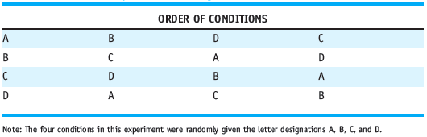
Correlated-Groups Designs (cont’d.)
Latin square: a counterbalancing technique to control for order effects without using all possible orders
Table 9.1 A Latin Square for a Design with Four Conditions

Slide 24
Correlated-Groups Designs (cont’d.)
Matched-subjects design
  A type of correlated-groups design in which subjects are matched between conditions on variable(s) that the researcher believes is (are) relevant to the study
A within-subjects design has perfect matching
Why do we not simply use a within-subjects design?
  Carryover effects

Slide 25
Correlated-Groups Designs (cont’d.)
Advantages of matched-subjects designs
  Testing effects and demand characteristics are minimized in comparison to a within-subjects design
  Groups are more equivalent than those in a between-subjects design and
  Almost as equivalent as those in a within-subjects design

Slide 26
Correlated-Groups Designs (cont’d.)
  Same types of statistics used for the within-subjects designs are used for the matched-subjects designs
Weaknesses of matched-subjects designs
  More subjects are needed than in a within-subjects design
  Mortality is more of an issue
  Difficult to find enough subjects who are matches

Slide 27
Summary
Consider several factors when designing and evaluating a true experiment:
  Address the issues of control and possible confounds
  External validity
  Use the most appropriate design

